Slide 1
INFORMATION RETRIEVAL/ REFERENCE TOOLS

Slide 2
INFORMATION RETRIEVAL
The activity of obtaining information resources relevant to an information need from a collection of resources.
Otherwise known as Information Storage and Retrieval (ISR or ISAR) or Information Organization and Retrieval.
Provides access to books, journals and other documents.
Simple application is finding factual materials in an encyclopaedia and a dictionary.
Web search engines are the most visible.

Slide 3
STEPS FOR RETRIEVING INFORMATION
Most IR systems compute a numeric score on how well each object in the database matches the query, and rank the objects according to this value.
Process begins when a user enters a query into the information resource system .
- Queries are formal statements of information needs e.g. search strings in web search engines. A query does not uniquely identify a single object in the collection. Instead, several objects may match the query, perhaps the difference is in the degrees of relevance.
- Object is an entity that is represented by information in a database.

Slide 4
STEPS FOR RETRIEVING INFORMATION Cont’d
User queries are matched against the database information.
Depending on the application the data objects may be ext documents, images, audio, mind maps or video.
IR results when the search provides information as the direct answer to the question
    - the inquirer reviews the material to see if it satisfies his request
    - the same would be true for data retrieval

Slide 5
INFORMATION RETRIEVAL TOOLS
Definition - Materials used to gather or source for information in reference sources
Systems created for the retrieval of information
Essential basic building blocks for a system that will organize recorded information collected by libraries, archives, museums etc
Retrieval tools used include indexes, catalogues, bibliographies, registers

Slide 6
What is a Reference Tool?
A book that can be used by itself as a source of information without use of a second source of information.
Reference tools or sources provide answers to
- specific questions, such as brief facts, statistics, and technical instructions;
- background information;
- directs you to additional information sources.
reference sources do not normally circulate and are located in a separate reference collection. This practice makes reference sources readily available and easily accessible.

Slide 7
Characteristics of a Reference Tool
Designed to be consulted rather than read through.
Can be arranged alphabetically, topically, or chronologically.
Many will contain cross listed information and more than one index.
There are thousands of reference sources available that cover practically every subject.
Although the term reference "book" is frequently used, reference sources can be books, serials, on-line databases or the Internet.

Slide 8
Reference Tools
Usually include access components such as indexes that lead to information elsewhere in the tool itself, rather than to other sources of information.
Most often reference tools cannot be used effectively without using access points included in the reference tool. It is therefore important to look for indexes and other access keys in reference tools.
There are two major categories of reference materials - general and subject.
-General sources include all subjects and present
overviews of topics.
-Subject reference sources focus on specific subjects
and can provide more in-depth coverage.

Slide 9
Examples of Reference Tools
  Dictionaries,
  Encyclopaedias
  Almanacs
  Atlases etc.

Slide 10
Dictionaries- definition
Provide information about words.
Contain words of a language or terms of a subject arranged in some definite order, usually alphabetically with explanation of their meaning and use
may be abridged or unabridged.

Slide 11
Dictionaries - Types
General dictionaries
Most familiar to us.
includes Webster's International Dictionary, the Random House Dictionary of the English Language, and the Merriam-Webster Collegiate Dictionary.
sources generally provide definitions, pronunciations, syllabication, and usage.

Slide 12
Dictionaries - Types
Subject dictionaries
focus on word definitions in a subject area, such as finance, law, botany, electronics, physics, etc.
Bilingual dictionaries
translates words from one language to another (e.g., Castel’s Spanish-English Dictionary, Collins English-French Dictionary)

Slide 13
. Dictionaries-Types- cont.
Historical dictionaries
provide the history of a word from its introduction into the language to the present- e.g. The Oxford English Dictionary
Etymological dictionaries
emphasize the analysis of components of words and their cognates in other languages
emphasize the linguistic and grammatical history of the word usage e.g. Oxford Dictionary of English Etymology.

Slide 14
Dictionaries-Types- cont.
Period or scholarly specialized dictionaries
focus on a particular place or time period. For example, try the Dictionary of Alaskan English if you would like to know when the word "cheechako" was first used.
Foreign language dictionaries
are fairly self-explanatory. We have all looked up words in a French or Spanish or other Western European language. Don't forget other wonderful dictionaries, such as the Yup'ik Eskimo Dictionary or the Inupiat Eskimo dictionary.

Slide 15
Dictionaries-Types- cont.
Thesaurus
synonyms (and often antonyms) for words (e.g., Roget’s Thesaurus)
Other dictionaries
Include dictionaries of slang, abbreviations, acronyms, reversals, rhyming, idioms, phrases, and guides to correct usage-e.g. Dictionary of Acronyms and Abbreviations, The Macmillan Dictionary of Historical Slang, Roget's II: The New Thesaurus, The American Language, Strunk's Elements of Style.

Slide 16
Dictionaries-Types- cont.
Biographical dictionaries
contain short articles about people's lives.
General biographical dictionaries
include Current Biography, Dictionary of American Biography, Who's Who, Encyclopaedia of World Biography, etc
Subject biographical dictionaries
may focus on a subject area or group.
include Dictionary of Scientific Biography, Contemporary Authors, Biographical Dictionary of Psychology, New Grove Dictionary of Music and Musicians, Women of Science, etc.

Slide 17
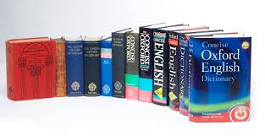
Dictionaries contd.

Slide 18
Encyclopaedias definition
are systematic summaries of all the information significant to mankind
Uses
provide general background information;
are good place to start researching a topic that you know little about.
cover large subject areas or disciplines in broad articles that explain basic concepts.
such overview articles often contain references to more specific aspects of the larger topic and may include a bibliography that leads you to more in-depth sources.
may be general or subject specific

Slide 19
Encyclopaedias-Types
General encyclopaedias
usually arrange articles alphabetically by topic.
have an accompanying index which may list cross-references to other articles. e.gs. are Encyclopaedia Britannica (29 volumes), The Cambridge Encyclopaedia, Encyclopaedia Americana, and the Columbia Encyclopaedia.

Slide 20
Encyclopaedias-Types
Subject encyclopaedias
are available for almost every academic discipline
provide more in-depth and technical information than general encyclopaedias.
generally assume some prior knowledge of the subject. e.gs. of subject encyclopaedias include the McGraw-Hill Encyclopaedia of Science and Technology, International Encyclopaedia of the Social Sciences, Encyclopaedia of World Art, Encyclopaedia of Philosophy, and the Encyclopaedia of Archaeology

Slide 21
Encyclopaedias-Types
Abridged encyclopaedia
are generally in one volume which is portable and occupies very little space.

Slide 22
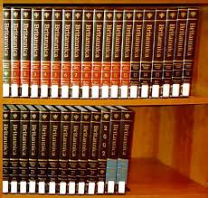
Encyclopedia contd.

Slide 23
Directories- definition
Refers to list of persons or organizations, systematically arranged usually in alphabetic or classified order, giving addresses, officers, affiliations, etc. for individuals and address, organizations.

Slide 24
Directories- uses
May be used for locating the correct names and addresses of people, dates and places of birth, commercial and/or social affiliations, universities attended and degrees earned, religious, political and fraternal affiliations, family data and similar information.
Provide names, addresses, affiliations, etc. of people, organizations, or institutions.
Can be used to verify addresses, name spellings, and provide contact information.
Directories may be general or focused on a particular subject.

Slide 25
Directories-Types
General directories
Zip Code & Post Office Directory, Encyclopaedia of Associations
Subject directories
Fairbanks Phone Directory, Museums of the World, A Directory of Eskimo Artists in Sculpture and Prints, Directory of Multinationals, Federal Government Agencies Directory (Hierarchical), Thomas Register of American Manufacturers, Scholarly Societies Project.

Slide 26

Directories contd.

Slide 27
Other Reference Tools- Geographical Sources
Geographic information is located in,
ATLASES
GAZETEERS
MAPS

Slide 28
ATLASES
Contain collections of maps.
Provide information on geographical/political changes- e.g. world, national, and thematic atlases and these may be current or historical.
World atlases
include National Geographic Atlas of the World.
National atlases
National Atlas of Ghana, Atlas of the American Revolution.
Thematic atlases
focus on a specific subject area, such as astronomy or agriculture. Examples include, The Oxford Economic Atlas of the World and the Environmental Atlas of Alaska.

Slide 29

Atlas contd.

Slide 30
Gazetteers
Are sometimes referred to as geographical dictionaries
provide descriptions of places, but no maps.
General gazetteers
include Webster's New Geographical Dictionary, The Columbia Lippincott Gazetteer of the World, Gazetteer of Undersea Features, The World Gazetteer, etc.
Regional gazetteers
focus on a specific geographical region
are good places to look for information on the location of a town, its population, or where its name came from
e.g. Dictionary of Alaska Place Names

Slide 31
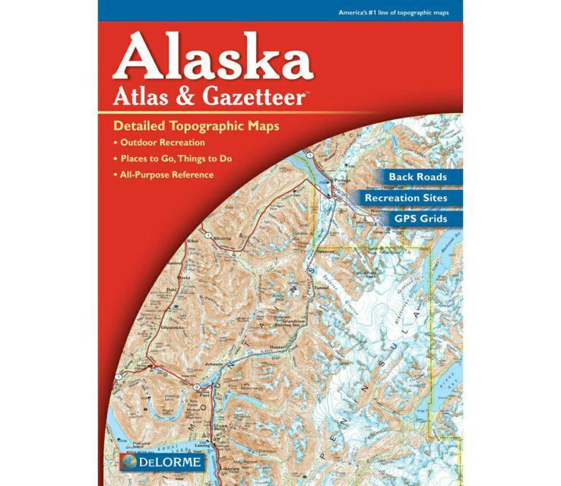
Gazetteers contd.

Slide 32
Almanacs- definition/Types
They contain statistics and facts about countries, events, personalities, or subjects. Almanac resources have call numbers that begin with AY.
General almanacs include the Statistical Abstract of the United States, The New York Public Library Desk Reference, World Almanac (an American focus), Information Please Almanac (print ed. called Time Almanac), and Whitaker’s Almanac (United Kingdom focus)

Slide 33
Almanacs
Subject almanacs include The Weather Almanac, The Almanac of Renewable Energy, Political Reference Almanac, Alaska Almanac, and more.

Slide 34
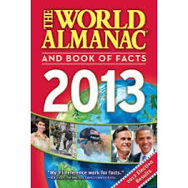
Almanac contd.

Slide 35
Handbooks/Manuals
are subject area tools.
provide facts, terms, concepts, movements, etc. of a topic.
provide detailed instructions on a particular subject, such as how-to-do something or how something works

Slide 36
Handbooks/ Manuals
Handbooks- examples
Handbook of North American Indians, Guide to Alaska Trees, Words and Ideas: A Handbook for College Writing, Handbook of Mathematical Formulas, MLA Handbook For Writers of Research Papers.
Manuals- examples
Manual of Photography, Manual for Environmental Impact Evaluation, Alaska Craftsman Home Building Manual, United States Government Manual

Slide 37
Indexes
a list of bibliographical information or citation to a body of literature arranged in alphabetical order of specified datum.
used to assist users be aware of and learn something about books
only provide author, title, and subject information
some online index databases also include the full-text of the article- examples include Reader's Guide to Periodic Index

Slide 38
Review & Criticism Sources- types
are tools that provide reviews or critiques of a person's work.
General- examples
Book Review Digest (OCLC FirstSearch, hereafter called FirstSearch), MLA (FirstSearch), New York Times Book Review, Contemporary Literary Criticism, Children's Literature Review, Popular Music Record Reviews

Slide 39
Historical Tables, Chronologies, Historical Yearbooks
Historical tables and chronologies may span long or very
short time periods.
Historical yearbooks provide facts and statistics for a single year and may be published annually.
Historical Tables
present historical facts in different formats.
provide facts chronologically in columns with each column representing another geographical area or other major area, such as history, economics, religions. etc.
Examples -The Timetables of History, Historical Tables, 58 BC-AD 1985.

Slide 40
Historical Tables, Chronologies, Historical Yearbooks- examples cont.
Chronologies
chronologies use narrative form to present facts.
Examples - Chronology of World History, The New York Public Library Book of Chronologies, Chronology of the Expanding World, 1492-1762, A Chronology of the People's Republic of China from October 1, 1949, Annals of European Civilization, 1501-1900.
Historical Yearbooks: The Statesman's Year-Book

Slide 41
Indexes & Abstracts
Abstracts
tend to be more descriptive.
Some online index databases also include the full-text of the article.
examples include Reader's Guide to Periodic Index, Book Review Index, and Periodicals Abstracts, Art Abstracts, New York Times Index, Biography Index, Chemical Abstracts

Slide 42
Bibliographies
lead to other information sources.
are lists of books and other materials that provide author, title, and publication information.
Annotated bibliographies also include a brief description or summary of the item.
are available on almost every topic and may focus on specific persons, groups, subjects, or time periods.
many bibliographies are selective and do not attempt to include all publications.
are sometimes referred to as "Guides to the Literature”

Slide 43
REFERENCE TOOLS - Catalogue
an essential tool for locating information on books in the library’s collection.
arranged under Author, Title or Subject.
cards for a specific book or material contains the same information, to locate a given book if the author, title or just something about the subject matter is known

Slide 44
Ready Reference Collection
contains reference sources that are used most frequently.
The Ready Reference shelves are located adjacent to the Reference Desk.
include reference tools such as encyclopaedia and dictionaries.
Examples
The Encyclopaedia of Associations,
The Dictionary of Alaska Place Names,
Style guides (MLA, APA, Chicago),
a thesaurus,
The Physician's Desk Reference,
Alaska phone directories,
Black's Law Dictionary,
World Almanac,
The Merck Manual of Medical Information,
Zip Code Directories, etc.

Slide 45
Types of reference assistance
  Assistance or instruction in the use of the library, including location of materials, use of the catalogue, use of computers to access information, and the use of basic reference sources.
  Assistance in identifying library materials needed to answer a question.
  Providing brief, factual answers to questions, such as addresses, statistics, phone numbers, that can be quickly located.

Slide 46
Where to find Reference Materials at KNUST Library
All materials in the Reference Collection can be found by searching the library catalogue.
Once you determine what type of reference source you need, simply do a subject or keyword search for that tool.
All items with a REF location code in the call number are located in the main Reference Collection.

Slide 47
Location of Reference Materials in the Library
Reference tools can be found in the Reference Section/Department
Such collection can be found by searching through the library catalogue.

Slide 48
Quick guide for selecting the right type of reference source
For Information About….. | Choose
Words | Dictionaries
General information/Overview of topic | Encyclopaedia
Names & addresses of people, organizations, institutions, companies | Directories
Profiles of people | Biographical dictionaries
Places/Maps | Gazetteers or Atlas
Facts and statistics | Almanacs
Formula, tables, how-to-do-it | Handbooks and Manuals
A person's work | Reviews or Criticisms
Dates, outlines, historical timelines | Historical Tables, Historical yearbooks
Periodical Articles | Indexes or Abstracts
Books and other sources to literature | Bibliographical guides

